Slide 1
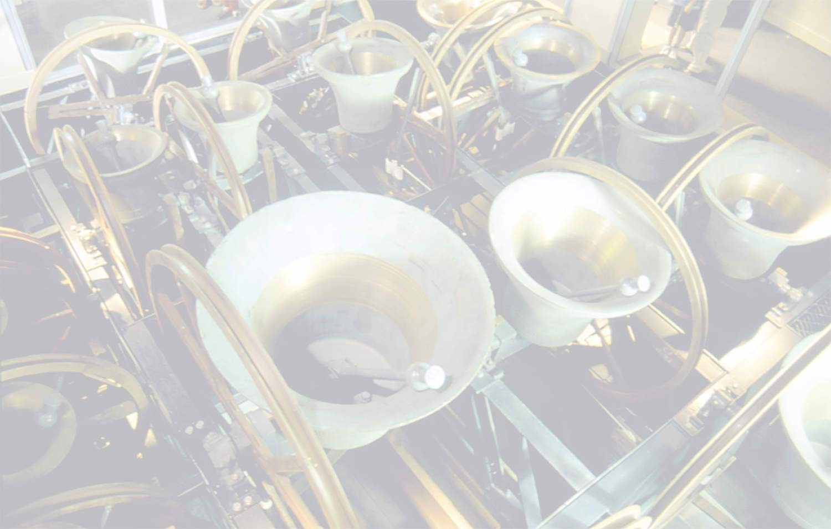
A Short History of English Church Bells and Bell Ringing
With thanks to and acknowledgment of the Association of Ringing Teachers

Slide 2
The Meanings of Bells
One bell or a whole peal calling over the centuries:
To wake
To pray
To work
To celebrate
To arms
And in times of crisis, to come together
Notes:
NOTES FOR PRESENTERS – THE NOTES HERE ARE SUGGESTIONS BUT TRY TO USE YOUR OWN WORDS AND EXPERIENCES AS THE BULLET POINTS COME UP ON THE SLIDE WITH EACH CLICK, NOT JUST READ OUT THE NOTES!
The sound of bells ringing is deeply rooted in British culture. Almost everyone in Britain lives within hearing range of bells. They provide the grand soundtrack to our historic moments, they rejoice when we celebrate and toll in empathy with our grief.
The bitter-sweet sound of just one bell or the majesty of a whole peal, has become part of the English heritage and much of the country's history can be traced through the history of its bells. They call us to wake, to pray, to work, to arms, to feast, to celebrate and, in times of crisis, to come together.

Slide 3
Ancient History
First, travelling preachers announced their arrival with handbells
As more churches were built, bells got bigger!
400 AD Paulinus, Bishop of Nola (Northern Italy), ordered adoption in his diocese
550 AD becoming more common in Europe
750 AD Archbishop of York regulated times of ringing
975 AD Archbishop of Canterbury made bells compulsory in all his churches
Notes:
The early missionaries used small handbells to call people to worship, with bells being introduced into Christian churches around 400 AD by Paulinus, Bishop of Nola in Campania. Their adoption on a wide scale does not become apparent until about 550, when they were introduced into France and Italy before spreading to Great Britain by monks and friars coming to join religious orders.
By 750, they were sufficiently common for the Archbishop of York to order all priests to toll their bell at certain times. St Dunstan, the then Bishop of London and Archbishop of Canterbury, hung bells in all churches under his care during the late 10th Century and gave rules for their use.

Slide 4
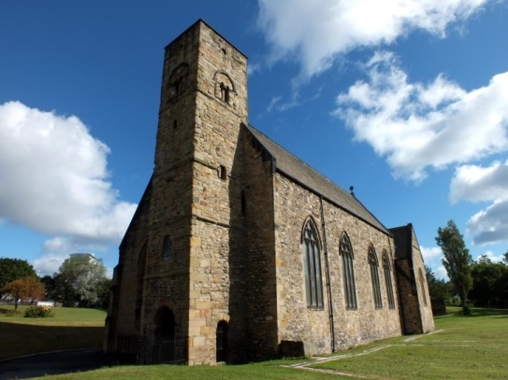
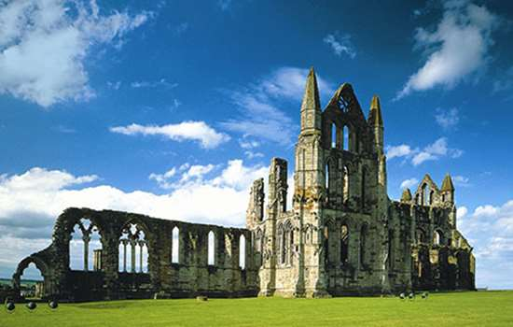
Up to and Including the Middle Ages
Bells ringing themselves?
Bells driving away the Plague (and bad weather!)
Developments in bell-hanging technology and therefore in ringing
Whitby
Wearmouth
Notes:
The hanging of bells in British churches spread quickly with the Abbeys of Wearmouth (right) and Whitby (below) both recorded as having bells in 680. Popular superstition alleged that bells could ring themselves. It is said that those of Canterbury Cathedral tolled themselves when Thomas-a-Becket was murdered. Bells were also deemed to drive away illness and bad weather.
Before the reign of Henry VIII and the Protestant Reformation, most bells in churches and monasteries were hung on a simple spindle and chimed by Deacons pulling a rope.
Ringers began to experiment with new ways of hanging the bell to get greater control. The first improvement was mounting bell with a quarter wheel with a spindle serving as the axle and the rope attached to the rim of the wheel. As this method grew popular, bells then began to be mounted on half wheels allowing them to be swung more vigorously.

Slide 5
The Reformation and After
Quarter and half wheels superseded by whole wheels
Stay and slider allow full control of bell
New technology and increasing wealth led to more bells
Ringers now mostly non-clergy
Ringers piecework-paid
Notes:
Following the Reformation, many churches began to rehang bells, with most using the new technology of bells mounted on a whole wheel. This gave much greater control using the rope, giving more pulling power for heavier and louder bells, but the final refinement was a stay and slider to be able to ‘set’ the bell. The ringer could now rotate the bells 360 degrees and stop and start the ringing at will.
The cost of maintaining bells and payments to the ringers could be quite a high proportion of running the Parish. St Margaret's, Westminster paid ringers one shilling each for ringing at the beheading of the Queen of Scots. Less than twenty years later, the same church paid ten times that for ringing ‘at the time when the Parliament House should have been blown up’.

Slide 6
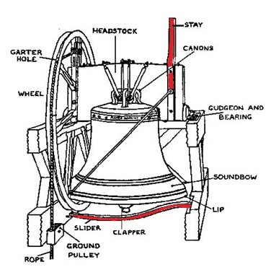
All the bits!
An illustration of a bell in the ‘down’ position, showing all the different parts that make up the mechanism.
Notes:
NOTES TO PRESENTERS, EXPLAIN HOW THE BELL WORKS AND END WITH THE POINT ABOUT The ‘stay’ and ‘slider’ (in red) are the key parts that enable the English-style of Change Ringing.

Slide 7
Early Development of Change Ringing
New technology spread and bell numbers in towers increased (competition with other churches)
More bells, more ringers
Payment to ringers now more frequent outside of London
Often paid in beer or cider!

Slide 8
Change Ringing Takes Off!
Societies of ringers formed (Lincoln 1612)
Mid 17th century development of ‘change ringing’
Idle young rich took up ‘The Exercise’
Bands of ringers in fierce competitions
1668 first book on change ringing published
1677 Stedman published his second book ‘Campanologia’ introducing his own compositions
Grandsire and Stedman’s Principle still rung today
Notes:
New technology spread and there was competition for who had the most bells – similar to the desire to have taller spires and higher towers. There was a long development period in the mid-17th century when orderly ringing involving ringing ‘changes’ began to take place. The combination of easier control using the whole wheel and the development of change ringing led to increased interest from the lay people, who took over the belfry from the clergy. The Ordinances of the 'Companie of Ringers of the Blessed Virgin Mary of Lincoln' were sealed on 18 October 1612, making it the oldest surviving Association. There is evidence that ringers were paid by the Cathedral to ring in the late sixteenth century, making this Society the oldest to be able to trace a continuous existence for at least 400 years.
The better-known Ancient Society of College Youths was founded in 1637 and continues to this day to provide bell ringers for St Paul’s Cathedral and Westminster Abbey.
During the reign of James II (1633-1688) bell ringing became extremely fashionable amongst the aristocracy - it provided physical exercise and intellectual stimulation. In the rural churches, however, bands of ordinary ringers strived to outdo one another. On days of competitions ringing was often preceded by a large meal at the local tavern and followed by the presentation of a ‘good hat’ or a pair of gloves to each ringer in the band that had performed the best.
The recreation began to flourish in and around London during the late 17th Century. An important milestone in the development of change ringing was the 1668 publication by Richard Duckworth and Fabian Stedman of their book ‘Tintinnalogia’, which promised in its subtitle to lay down "plain and easie Rules for Ringing all sorts of Plain Changes". Stedman followed this in 1677 with another famous early guide, Campanalogia. This mentions dozens of newer methods including introducing his Grandsire Method and his Stedman's Principle.

Slide 9
Change Ringing Climbs Higher!
Rapid development of ‘methods’
Many named after cities and counties e.g. Norwich and Kent
Peals of more than 5,000 changes rung
First recorded true peal rung May 2nd 1715 at St Peter Mancroft, Norwich
Commemorative peal board, St Peter Mancroft
Notes:
Stedman’s two books setting out the rules for change ringing, still followed today, started an avalanche of others. The books described the art of change ringing and drew up rules for long series of changes, whereby bells changed place at each pull of the rope. Further rules soon evolved and changes could be worked out, written down and learned by heart to create patterns where the bells are never sounded in the same order twice. These compositions were named ‘methods’ and soon hundreds were created, often named after the cities they were first rung in such as Norwich, London or Cambridge.

Slide 10
Peals Become Public Entertainment
Change ringing really arrived by mid 18th century
Long lengths
Peals over 3 hours common
Rules:
no stopping
no talking
no eating or drinking
no artificial aids – memory alone
Notes:
By the middle of the 18th century many newspapers indicate that the ability to stand for three hours and to ring a peal of 5040 changes was common and also that there was a crowd of listeners near and far eager to hear.
At Leicester in March 1731 one of the ringers commented; “we upon bells completed the whole peal of Grandsire Triples in three hours and two minutes to the great satisfaction of thousands both in town and country”.

Slide 11
Church’s Backlash and Belfry Reform
By mid 19th century bellringers had:
low social esteem, bad behaviour
poor relations with church, often fiercely independent
Response = Belfry Reform Movement:
part of re-awakened interest in the church generally
standards improved, change ringing supported
officers appointed in towers with clergy back in control
towers and ringers became ‘respectable’
Notes:
Change ringing began to lower in social esteem, with swearing, smoking and, on occasion, a barrel of beer in the tower! Some belfries became notorious as the meeting place of the village riff-raff, who indulged in drinking and riotous behaviour. A rift developed between ringers and clergy, with some towers closed by their incumbents.
The ringers were usually very independent, reserving the right to choose when to ring. At High Wycombe, Bucks in 1832 the bells rang out to celebrate the passing of the Reform Bill but a few days later on the occasion of the annual visit of the Bishop the ringers refused to turn out as a mark of their disapproval at his having voted against the Bill in the House of Lords. The Victorian reform of the Church of England included a re-examination of practices used since the Reformation. In 1839, the Cambridge Camden Society began a national spring clean of churches, including the tower and bell ringers. Rectors were reinstated in control of bell towers, despite many groups of ringers who fought to preserve their ‘privileges’.
Church leaders wanted to improve the standard of ringing and, above all, to ensure proper and reverent behaviour in the ringing chamber and to encourage ringers to ring for and attend church services. Bell ringers were encouraged to appoint a Tower Captain to be responsible for the regular attendance and general conduct of ringers – including giving penalties for bad ringing or behaviour. By 1900, a new generation of ringers had emerged and bell ringing was once again respectable and part of the church.

Slide 12
20th and 21st Centuries?
Women became bellringers in large numbers
Bellringing declined after WW1
Church bells silenced for much of WW2
Interest increased from 1950s, then declined
Millennium and 2012 Olympics increased interest again
More new ringers now badly needed again
Notes:
By the late 19th Century, women began to take up bell ringing. Miss Alice White of Basingstoke was the first woman to complete a full peal in 1896. As more women became interested, the Ladies Guild of Change Ringers was formed in 1912.
After World War I, disillusion with politicians manifested itself in a swing against organized religion. The number attending church services fell hugely, and the number of bell ringers also declined. During the early part of World War II all church bells were silenced, to ring only to inform of an invasion by enemy troops. This had the effect of reviving interest in the art once peace had returned.
From 1950 there was a rapid increase in the numbers of bell ringers, especially young bell ringers, with an accompanying increase in the standard and complexity of ringing and activity.

Slide 13
Millennium, Olympics and Jubilee
5000 new ringers for 2000
95% of all church bells rung New Year’s Day
Games announced with biggest tuned bell ever
Ring of 8 bells on a floating belfry led the Thames Pageant
Notes:
5000 ‘Ring In 2000’ - This project was the largest national ringing event ever staged, aiming to attract 5,000 new ringers who learnt to ring in time for the Millennium. Approximately 95% of all the church bells in the UK were rung on 1 January 2000. The Olympic Games in London was announced with bells. Along the 8,000 miles of the Torch Relay bells rang to celebrate the passing of the Olympic Torch and at the culmination of the Torch Relay, and as part of the London 2012 Festival, at 8.12am on the day of the Opening Ceremony three minutes of ringing all kinds of bells captured the public’s attention to bell ringing and broadcast to an estimated audience of over 12 million people.
The great Olympic Bell then featured prominently in the Olympic Opening Ceremony. Commissioned from
Whitechapel Bell Foundry in London it was tolled by Tour de France winner Bradley Wiggins to open the Ceremony. At 23 tonnes it is the largest harmonically tuned bell in the world. As part of the Her Majesty the Queen’s Diamond Jubilee celebrations, eight bells were cast at Whitechapel Bell Foundry and led the Thames Pageant of 1,000 boats with a floating belfry from which the bells were rung. Those bells are now installed and regularly rung at St James’ Church, Garlickhythe in London

Slide 14
We hope you have found this presentation interesting. For further information please visit: https://cccbr.org.uk/services/pr/

