Slide 1


Ringing 2030
What can Associations do?
Notes:
This presentation was given to the CC Executive to present result of a research project into the risk to bells and ringing of changing churches. It was not limited to closing churches, because there are also situations in which access to bells stops even though a building is not closed for worship.

Slide 2
What is Ringing 2030?
Ringing 2030 is a major project to create a sustainable future for change ringing.
It was introduced to Council members at the Annual Meeting in September 2022.
Ringing 2030 is
  what we need ringing to be like in 2030
  what we need to change in order to get there
  making sure we effect that change.

Slide 3
Some base data
We have fewer ringers than we used to have
Our traditional sources of youth recruitment have disappeared
Our current ringing population is build on a youth base five times larger than what it is now

Slide 4
Successful recruiting events
Millennium Ringing (2000)
Ringing Remembers (2018)
Ring for the King (2023)
All of these driven by significant events.

Slide 5
Do you know who your ringers are?
Some associations don’t.
Associations are best placed to find that out:
  How many young people are ringing?
  Who are your teachers?
  Where are your hotspots? And blackspots?

Slide 6
What has the Council done for me?*
(is the wrong question)

Slide 7
Changes in churches
What are we going to do?
Presentation by
Simon Linford and Alison Hodge
Notes:
This presentation was given to the CC Executive to present result of a research project into the risk to bells and ringing of changing churches. It was not limited to closing churches, because there are also situations in which access to bells stops even though a building is not closed for worship.

Slide 8
In the press
“The 19 churches across Wigan which could soon disappear amid controversial closure plans” Wigan Today, 3 October 2023
“Truro Diocese "On The Way" to closing churches”
UKColumn 29 March 2023
“Church of England parishes close at record rate. Startling figures come as dossier accuses bishops and senior clergy of driving through controversial plans to cut costs and vicars.”
Daily Telegraph 2 September 2023
“Existential crisis as up to 700 churches predicted to close across Scotland by end of the decade”
The Scotsman, 11 November 2023
“Up to a quarter of Church of England Parishes have no wardens”
Daily Telegraph, 18 March 2024
Notes:
The general issue of church closures now has high public awareness as it is appearing in the press. The Daily Telegraph has had a lot of coverage as there is an editorial link with those behind the “Save the Parish” campaign.

Slide 9
Lincoln Diocese
Significant issues with churches at risk
Low average population per parish
Relatively poor
(lowest level of giving in any Diocese)
Only 4 Benefices actually cover the cost of their stipendiary clergy
Notes:
In our collection of data we only came across one Diocese which had actually done this analysis
It is one of the Dioceses with a particular issue

Slide 10
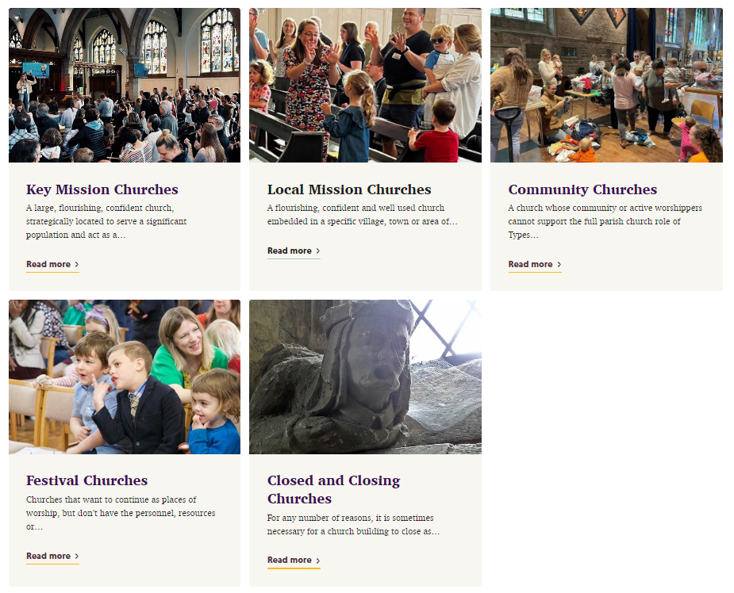
Lincoln Diocese
Category 1
Category 2
Category 3
Survey categorised all churches
Category 4
Category 5
Notes:
Survey gave the churches themselves the choice of category
Quick notes on Festival Churches. Going to say more about these later but Festival Churches only have to have 6 services per year., which isn’t necessarily bad for ringing access, but is not consistent with maintaining a regular local band

Slide 11

Lincoln Diocese
Walesby All Saints,
8, 12cwt Grade 5
Of their 624 churches:
Cat 5 31 (5%) None with rings of bells
Cat 4 178 (29%) 17 with ringable rings of 5 or more
Cat 3,2,1 414 (66%)
Correlation between churches at risk and churches with bells – 178 rings of 5 or more in LDG so 34% would 60
How many of the 178 Festival Churches will survive?
What does Festival Church status mean for ringing?
Notes:
We understand all of the 178 have been given Festival Churches status by the Diocese but as I’ll say later, that doesn’t mean they’re safe
Will that really be OK for bellringers? CCT Chief Exec thinks all those will close
May be reduced access, less ringing means less maintenance. Also less maintenance of the building potentially
On the positive side fewer services may mean more opportunity for ringing!
On the correlation, the churches most at risk in rural areas tend to be the churches with smaller rings of bells.
Still this looks like 10% of the rings of bells in Lincoln DG at risk in next 10 years
Lincoln DG well aware of this and is on the front foot

Slide 12
Festival churches
Breathing space for a church at risk
Minimum six services per year
(Canon Law service requirement removed)
PCC retained but encouragement to bring in new people with other skills
Parish share and maintenance costs stay
Must find new sources of income to survive
Notes:
Like going into administration
If the church hasn’t become sustainable in 5 years it will close – Nigel Mills
Ringers are going to be very welcome but we’ll need to pay our way
Experience of ringing at festival churches is good so far
Much better outcome than CCT!

Slide 13
Small parishes
Small parishes
(by population) carry particular risks of closure, usually after a period of steady decline
Notes:
Alison then did some work looking at the data on small parishes
You can see again that it is the rural dioceses that have a high percentage of small parishes – not really unexpected

Slide 14
Small parishes
Further analysis attempts to estimate the numbers of full circle rings at risk due to being in small parishes.
Note correlation with rural areas

Slide 15
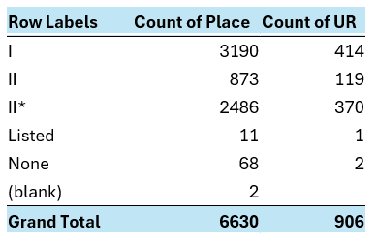
However, looking at churches which might be at risk because of a low level of listing shows a different picture:
Lower listed churches tend to be found in urban areas. If all the churches graded II were closed we would lose 14% of rings of bells!
(NB II* is intermediate listing category between I and II)
Notes:
Reminder – reason for a lower level of listing being a higher risk is that they are easier to shut and dispose of so they will be early targets.
The Church of England feels that it is hampered by these buildings and wants to get rid of them.
When you read strategic Diocesan stuff they often refer to promoting and developing new “expressions of church”. “Expressions of church” are not generally in buildings with bells.

Slide 16
Transforming Wigan!
Liverpool Diocesan plan for Wigan Deanery
Reduce to one super benefice “Church Wigan
5 established new significant ‘expressions of church’ (i.e. each containing at least 50 hitherto unchurched or de-churched people)
5 emerging new significant ‘expressions of church’
Rationalisation of 33 church buildings
Clergy centralised in single team ministry
Increase giving by £500,000
500% increase in young people going to church
Provide a template for the future at a cost of £1.2m
Five years later…
Church attendances reduced by a third
Giving decreased by £500,000!
Clergy numbers reduced from 24 to 13
29 former parishes lost their PCCs
19 churches listed as at risk of closure including
All Saints Wigan (10, 30cwt)
St Peter’s Hindley (8 13cwt)
Notes:
The types of building at risk in urban areas is different
Lancashire has a particular issue with urban expansion in Victorian times. Large Victorian churches in high population areas, are now large churches in non-Christian and low income areas. Similar issues in Birmingham. Ashton under Lyne has to be at risk. Bacup has been a problem for ages – removal of bells has now been blocked by the Commissioners until after sale of the church. “We feel the acquisition and relocation of Christ Church Bacup bells is slipping away.“
Wigan Deanery had issues – low attendance, low giving

Slide 17

Truro Diocese
‘On the way’
Leicester Diocese
‘Shaped by God together’
Similar Diocesan reorganisation under consultation in Truro and Leicester
“Minster Communities are groups of churches and fresh expressions working collaboratively and sharing resources to enable effective mission.”
Notes:
These reorganisations don’t tend to support individual parishes and PCC – have to be a risk to ringing.
Sorts of church that are seen as the future are not the sorts of churches that have rings of bells.
Leicester needs to find an additional £2m a year, or savings of that amount
Church buildings are a beloved sign and enabler of local missional presence, whilst it is hard to see all can be fully maintained by the congregations or even communities, in which they are set; Revd Barry Hill, Diocesan Strategy Development Enabler

Slide 18
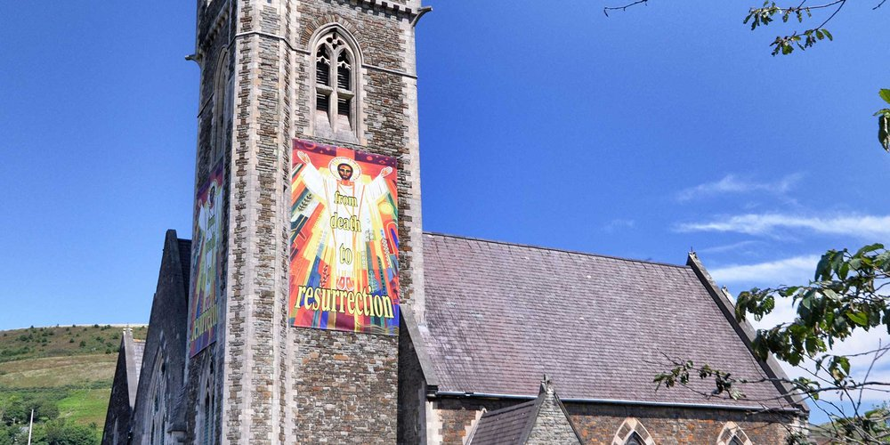
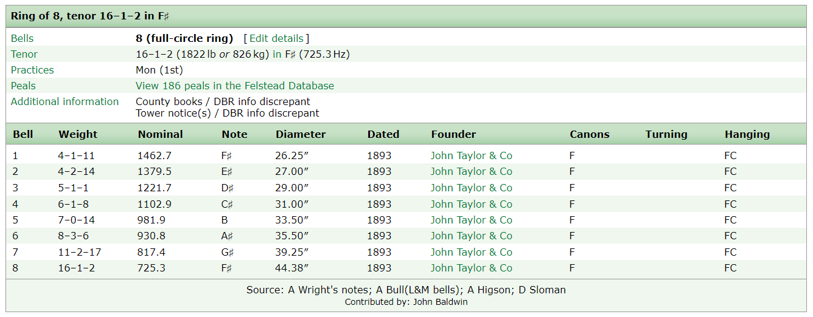
Aberavon
Good 16cwt eight
Heavily used by Llandaff & Monmouth
Active local band
186 peals
Church in need of major repairs
Closed with three months’ notice – last service Sunday 21st April
No access to bells pending a decision on the future of the building
Notes:
The sudden loss of Aberavon highlights many of these issues. Became part of an 8 church Deanery Area, PCC lost control
16cwt is getting into the “difficult to find a home for” territory although we understand a home has been found for these but it remains confidential
Also a local rumour that a local group is hoping to turn the church into a museum with the bells remaining
Wales has a particular issue with closing churches and the societies are very worried.

Slide 19
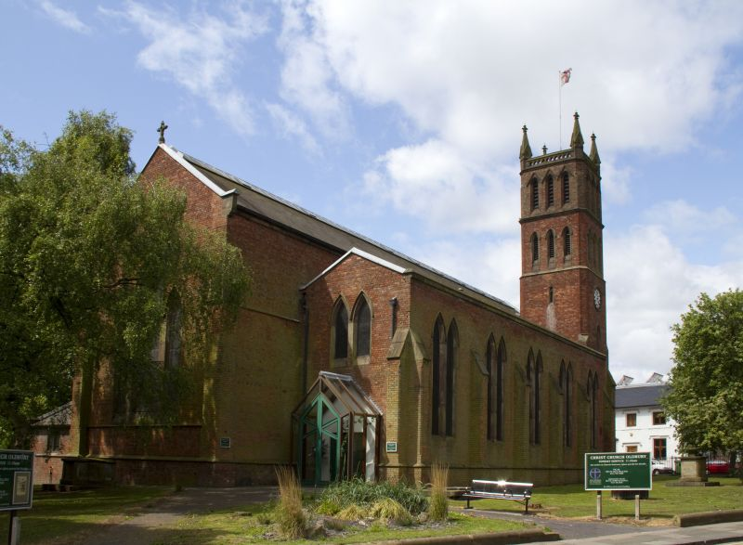
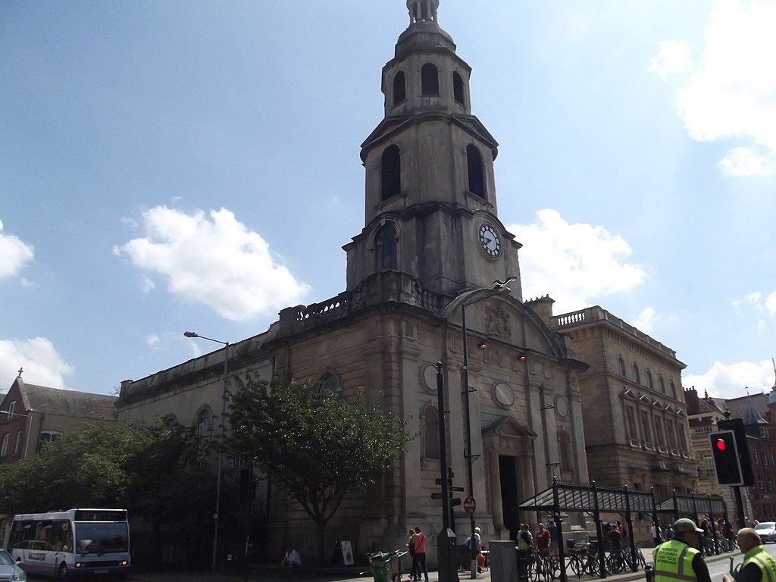
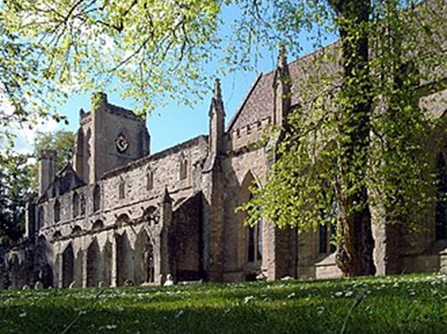
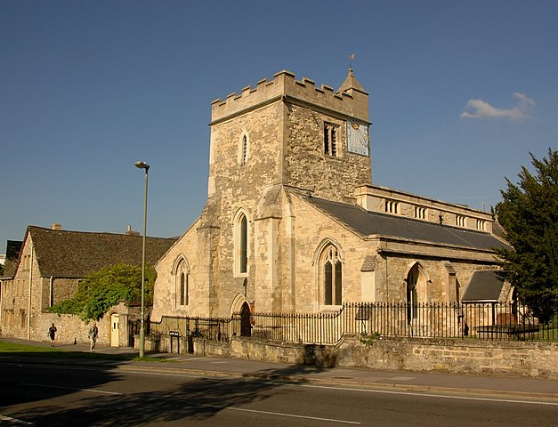
Other ways of losing access
Notes:
Rings of bells lost as a consequence of finding a sustainable use for the building
Point of this is that the Diocese will prioritise finding a new uses and doing a deal – what happens to the bells tends to be an annoyance and not a consideration

Slide 20
How to identify churches at risk?
Attendance below 25
Unaffordable repair costs
Multi parish benefice
Multi church parish
Low level of heritage listing (Grade II or none)
Poor/deprived area
Lack of PCC members and other volunteers
Notes:
Aberavon ticked most of these boxes

Slide 21
Issues for ringing
What are we going to do about all these rings of bells?
Quite difficult to rehome larger rings. Cleator Moor have only just been rehomed despite being removed in 2017
Should we be considering where we put rings of bells? (Keltek Trust now reporting projects put on hold due to concerns over church future)
Where do we store them?
Who owns the bell fund?
Notes:
Heavy rings – It is now difficult to relocate high quality heavy rings of bells and almost impossible to relocate heavy pre-True Harmonic rings. The current demand is mainly for rings of bells with a tenor weight of 10cwt or less.
We are seeing projects put on hold because of the perceived long term future of the church building.

Slide 22
Feedback from Keltek Trust
Regarding church closures – we believe the way forward is:
To collect a list of churches (or other buildings) which are prepared to accept a ring of bells and assess what their needs are (number of bells, tenor weight etc.)
For useful bells to be removed before formal redundancy
For the Diocesan Furnishings Officers to offer a free transfer to any church within the UK. Many Dioceses do agree to a free transfer within the Diocese
For funding to be made available to install rings in “new” churches

Slide 23
Other things ringers can do
Be on the PCC! No excuse for not know what’s going to happen with enough notice to do something about it
Assess all BRF requests against the ‘Church at risk’ criteria (as above)
If funding for a new ring of bells does not come from the church itself, retain ownership and right to remove (needs thought/research into whether this is possible)
Start compiling the database of potential homes for rings of bells, including what it will cost to complete a project (note that is direct competition to the market for new bells
Identify the criteria for the ‘best’ rings/bells and consider the risks to them, and options
Work closely with DACs and DAC Bell Advisers, remembering that DAC Bell Advisers may well have a conflict of interests
Notes:
Not sure this would have helped at Aberavon. Once the church because part of the Deanery Group it seems the PCC no longer knew what was going on, and the role of the DAC Bells Adviser didn’t help.
Every association would need to do this for their towers
Might have to be done by some sort of trust
There isn’t really anyone capable of making this assessment so it would be based n a gut feel assessment of suitability

Slide 24
Conclusion
Hope for the best, plan for the worst
Over the next 10 years, 10-15% of churches with bells could either close or find new uses
Start considering where rings of bells might go, and do preparatory work
Rings of bells with a tenor over around 15cwt are very difficult to relocate
Societies and ringers need to become better aware and connected with the churches where they ring, and not forget the towers where there are no bands
Although church closure has tended to be a lingering death, Aberavon shows how quick it can be.

