Slide 1
Annual General Meeting Saturday 7th September 2024
Please take your seats by 1.50pm
When speaking, please use the microphone
Please state your name and affiliation

Slide 2
Annual General Meeting Saturday 7th September 2024

Slide 3
New Members 2024
Ex-officio (Non-voting): Andrea Haynes, Richard Pullin,
John Lagdon, Andrew Aspland
Representative Members:
Ancient Society of College Youths: Euan Thomas
Chester Diocesan Guild: Andrew Darling
Dorset County Association: Cathy Neyland
Gloucester & Bristol Diocesan Association: Ian Bucknell,
Jason Carter, Roger Haynes
Guild of Devonshire Ringers: Harry Andrews
Hertford County Association: John Allison
Irish Association: Lesley Hayes, Alex Nelson

Slide 4
New Members 2024
Kent County Association: Tom Winter
Lincoln Diocesan Guild: Keith Butter
Llandaff & Monmouth Diocesan Association: Harriet Moncrieff
Middlesex County Association & London Diocesan Guild:
Adrian Sweeting
North Wales Association: Esme Anstice
Scottish Association: Zoe Bennett
Swansea & Brecon Diocesan Guild: Grace Dooley
University of Bristol Society: Josephine Leggett
Welsh Colleges Society: Fiona Hartley
Winchester and Portsmouth Guild: Margaret Smith
Lilliputters Guild: Emily Watts

Slide 5
Annual General Meeting Saturday 7th September 2024

Slide 6
Apologies for Absence Apologies have been received from the following:
Ian Oram - Ex Officio
Steph Runting - Kent CA
Alexander Runting - Kent CA
Rosina Baxter - Beverley and District
Rhona McEune - Barrow and District
Tim Jackson - Ex-Officio
Sue Marsden – Ely DA
Bob Crighton - Sailsbury DA
Glen Fiddy - Derby DA
Enid Robers - ANZAB
Chris Povey - Four Shires Guild
John Allison – Hertfordshire
Edward Sterland - East Derbyshire & West Nottinghamshire
Toby Hibbet – University of London
Jayden Milby – Carlisle DG
Giovanni Camberari – ASCSV
Chris Hughes – St Davids Guild
John Couperthwaite – Guildford DG
Rob Lane – Sussex
Phil Bailey - Ely DA
Cath Coleman – Suffolk Guild
David Westerman – Peterborough DG
Duncan Walker – Carlisile DG
Derek Sibson - SRCY

Slide 7
Annual General Meeting Saturday 7th September 2024

Slide 8
In Memorium
The following Council Members died after the report for 2023 was compiled:
Brynley Alfred Richards, Southwell Diocesan Guild 1978 – 1981, 1984 – 2002, East Derbyshire & West Nottinghamshire Association 2014 – 2017, attended 24 meetings, died 7th May 2023
Roland Ferguson Eccles, Australia & New Zealand Association 1979 – 1990, attended 10 meetings, died 12 June 2023
Alan Paul Standley Berry, Honorary Member 1982 – 2000, 2004 – 2007, 2008 – 2010, Ex-officio Member 2010 – 2014, attended 21 meetings, died 11 July 2023
Jeanne Elizabeth Bottomley, Honorary member 1966 – 1971, attended 4 meetings, died 27 May 2023
David Oliver Knewstub, Australian & New Zealand Association 2002 – 2004, attended one meeting, died 10 August 2023

Slide 9
In Memorium
The following Council Members died after the 2023 Council meeting:
James Linnell, Peterborough Diocesan Guild 1966 – 1972, attended 5 meetings, died 15 September 2023
Giancarlo Tommasi, Veronese Society 1988 – 1990, 1996 – 1999, attended 6 meetings, died 16 September 2023
Wendy Piercy (neé Philips), Bedfordshire Association 1999 – 2011, attended 11 meetings, died 20 Seotember 2023
Peter Appleby Trotman, North American Guild alternate 1994 – 1996, member 1996 – 2008, Honorary member 2008 – 2010, Additional member 2010 – 2018, attended 20 meetings,
died 27 January 2024
Rev. David Lewis Cawley, Gloucester & Bristol Diocesan Association 1993 – 1996, attended 3 meetings, died 6 February 2024

Slide 10
In Memorium
Andrew Johnson, Winchester & Portsmouth Diocesan Guild 2017 – 2019, attended 1 meeting, died 20 February 2024
Joseph Edward George (Joe) Roast, Essex Association 1963 – 1972, attended 7 meetings, died 29 February 2024
Alan John Smith, Guildford Guild, 1981 – 1984, attended 3 meetings, died 11 March 2024
Rev. Giles Christopher Galley, Yorkshire Association 1989 – 1999, attended 10 meetings, died 9 April 2024
Garry Stephen Barr, University of London Society 1993 – 1999, London County Association 1999 – 2007, attended 14 meetings, died 27 May 2024

Slide 11
In Memorium
Donald A Trumpler, North American Guild (Alternate member)
1989 – 1992, attended 1 meeting, died 10 June 2024
John Robert Mayne, Middlesex County Association and London Diocesan Guild 1957 – 1966, Honorary member 1968 – 1989, Hertford County Association 1990 – 2002, attended 32 meetings, died 23 Jun 2024
Hans Rashbrook, Middlesex County Association and London Diocesan Guild, 2023 – 2024, attended no meetings,
died 8 July 2024
Alan Robert Bentley, Honorary member 2008 – 2010, Additional member 2010 – 2012, Oxford Diocesan Guild 2012 – 2015, attended 2 meetings, died 10 July 2024

Slide 12
In Memorium
Robert Christopher (Chris) Kippin, Ancient Society of College Youths 1981 – 1990, attended 9 meetings, died 18 July 2024
The following Council Members died after the 2024 report went to print.
Malcolm John Lodwick, St David's Diocesan Guild 1981 - 1982, Kent County Association 1984 - 1990, attended 5 meetings,
died 17 July 2024
Norman Richard Mattingley, Hereford Diocesan Guild 1981 - 1994, Truro Diocesan Guild 1996 - 2019, attended 34 meetings,
died 25 August 2024
David R McLean, Norwich Diocesan Association 1987-1990, 1993-1996, 2002-2005 and 2008-2011. Attended 11 meetings.

Slide 13
Annual General Meeting Saturday 7th September 2024

Slide 14
Membership of the Council
As of 26th August 2024
66 Affiliated Societies – 2 Small Societies
2 Fellows
17 Ex-officio
199 Representative Members - 27 Vacancies
2 Small Society representatives
220 Possible members –
Taking vacancies into account - 193 actual members

Slide 15
Annual General Meeting Saturday 7th September 2024

Slide 16
Ringing 2030
More people wanting to learn to ring
Teach them well and support their development
1
2
Put the quality environment around them so they enjoy it
3

Slide 17
Three Pillars
Publicity and Marketing: Raise awareness of the art of bellringing and promote it as a social and voluntary activity. Drive new recruits to us with better targeted marketing initiatives.
Recruitment and Development: Encourage the development of local and regional structures to recruit potential new ringers and attract lapsed ringers back to ringing, then ensure their expectations are met as they progress.
Quality Environment: Teachers, teaching structures, leadership, bell installations, ringing environments, safeguarding, etc. We have to create a quality environment that makes people enjoy ringing and want to stay doing it.
1
2
3

Slide 21
Annual General Meeting Saturday 7th September 2024

Slide 22
Motion A
That with effect from the close of the 127th Council Meeting on 7th September 2024, all Council Stewards shall retire no later than at the end of the ninth Annual Council Meeting after their appointment or election (instead of the sixth Annual Council Meeting), but otherwise in accordance with the provisions of Standing Order W2.2.
That the Council approves the future amendment of Standing Order W2.2 by the Executive to reflect the above change.
Proposed by: E de Legh-Runciman – Secretary
Seconded by: C Whittaker – Ordinary Trustee

Slide 23
Annual General Meeting Saturday 7th September 2024

Slide 24
Motion B
1. Change Standing Order F1.1 to: The Annual Subscription for each Affiliated Society shall be £0.40 per member of that Society based on its Society Membership. This change to come into force on 1st January 2025.
2. Change Standing Order F1.1 to: The Annual Subscription for each Affiliated Society shall be £1.00 per member of that Society based on its Society Membership. This change to come into force on 1st January 2026.
3. The Executive are requested to create a new Standing Order aimed at ensuring visibility in the statement of accounts of the Council for the year ended 31st December previous, required at the ACM by Rule 6.1 b) (2), of how the Council has performed as a charity.
4. The Executive are requested to create a new Standing Order aimed at ensuring visibility in the Executive’s forward plan and budget for the next year, required at the ACM by Rule 6.1 b) (3), of how sustainable the finances of Council are, and how it plans to use funds to further its objects.
Proposed by: Paul Wotton (Bath & Wells Association of Change Ringers)
Seconded by: Ian Roulstone (Society of Royal Cumberland Youths)

Slide 25
Annual General Meeting Saturday 7th September 2024

Slide 26
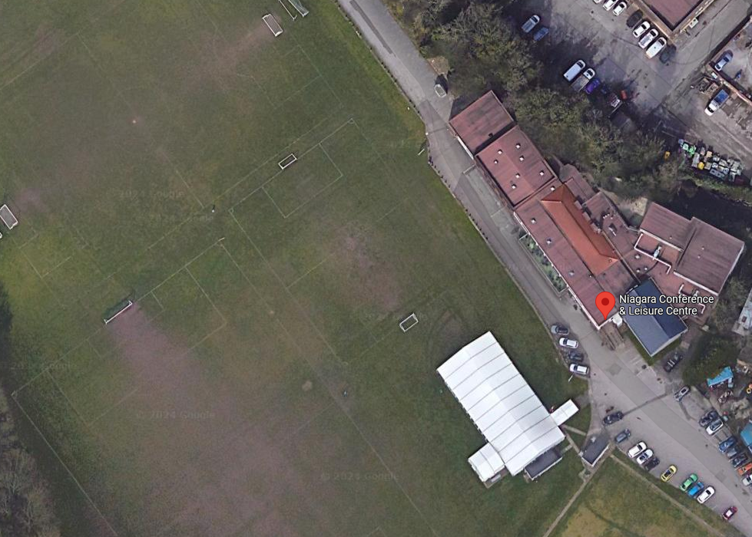
5-7 September 2025
Niagara Conference Centre - Sheffield

Slide 27
Annual General Meeting Saturday 7th September 2024

Slide 28
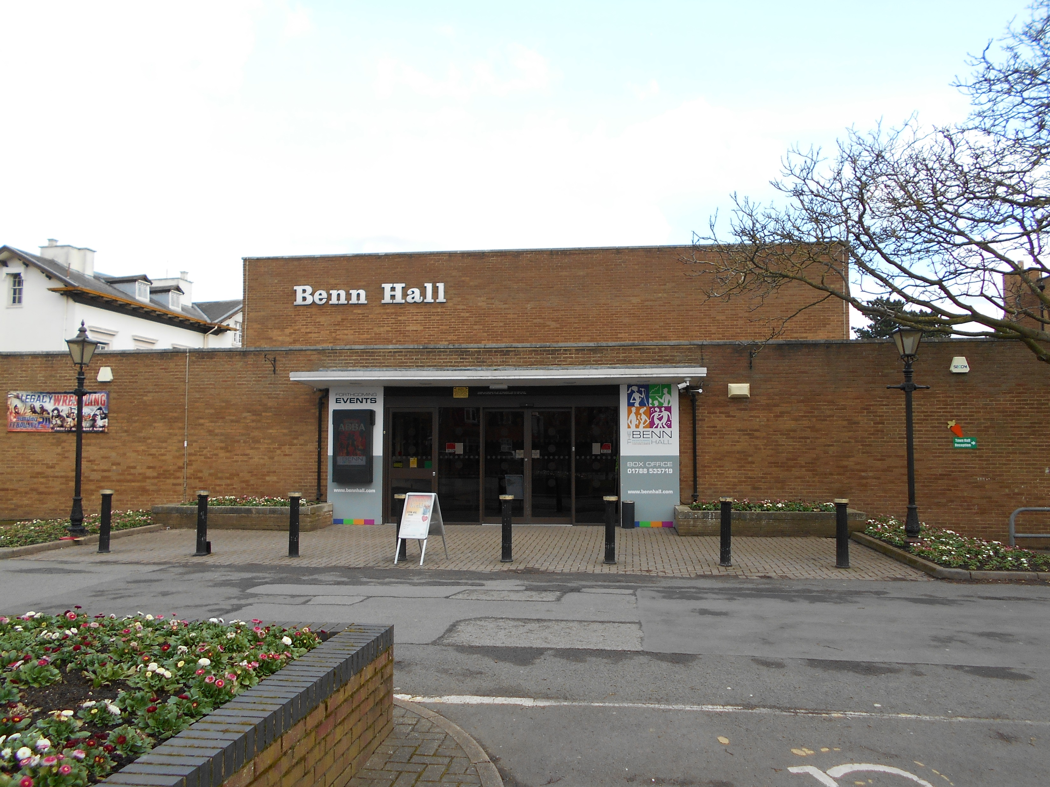
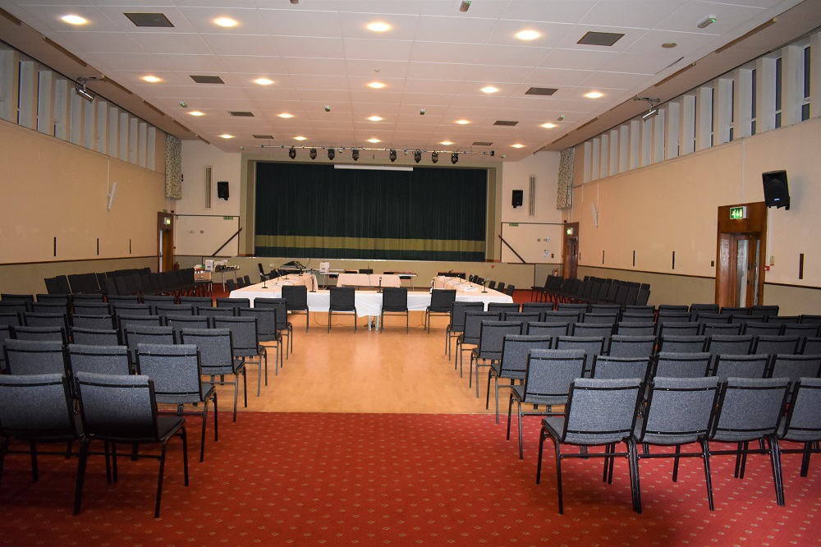
2026 CCCBR AGM
To be hosted by The Coventry Diocesan Guild of Church Bellringers on
September 5th 2026 – at “Benn Hall”, Newbold Road,
Rugby, CV21 2LN

Slide 29
Annual General Meeting Saturday 7th September 2024

Slide 30
Extra Slides if Needed

Slide 31
Roadshow Exhibitors Questionnaire Sent 4th March 2024
(follow up sent 16th March 2024)
25 Recipients
Association of Ringing Teachers | Avon Ropes
Bells of Whitechapel Ltd | Lewis Benfield (Handbells)
Big Wilfs Bell Muffles | Blythe & Co Ltd
Carillon Society of Britain & Ireland | David Bagley
eBells | Handbell Ringers of Great Britain
John Taylors | Loughborough Bellfoundry Trust
Matthew Higby & Co Ltd | Mobile Belfries Trust
Nicholsons Engineering | David Horrocks (Dumbell)
Simbell | The Ringing World
Whites of Appleton | Young Change Ringers Association
Keltek Trust | Westley
Soundweld | Paul Rapson (Peal Boards)
FoilPrint Metal Plaques (Peal Boards)

Slide 32
Roadshow Exhibitors Questionnaire – Responses
11 received
Association of Ringing Teachers | Avon Ropes
Bells of Whitechapel Ltd | David Bagley
eBells | Keltek Trust
Lewis Benfield (Handbells) | Matthew Higby & Co Ltd
Simbell | Soundweld
The Ringing World

Slide 33
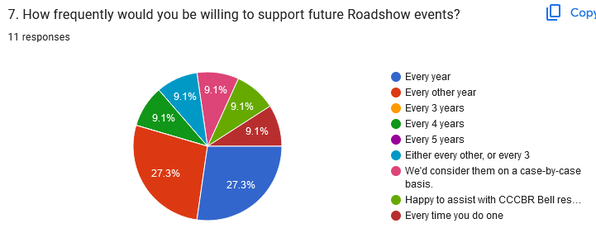
Roadshow Exhibitors Questionnaire – Responses

Slide 34
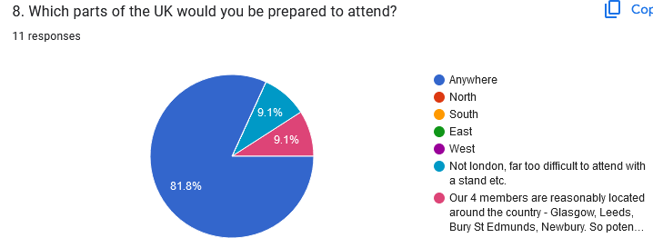
Roadshow Exhibitors Questionnaire – Responses

Slide 35
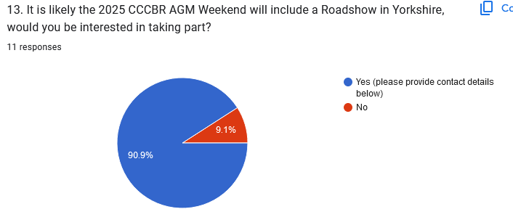
Roadshow Exhibitors Questionnaire – Responses

